Slide 1
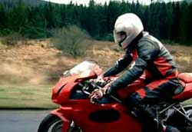

Motorcycle Safety in Great Britain
Andrew Colski,
Road User Licensing, Insurance and Safety Division,
UK Department for Transport

Slide 2
Powered Two Wheeler users
Killed or Seriously Injured GB 1994-2010

Slide 3
Powered Two Wheeler users
Killed GB 1994-2010

Slide 4
Powered Two Wheeler fatality rate per billion vehicle kms GB 2000-2010

Slide 5
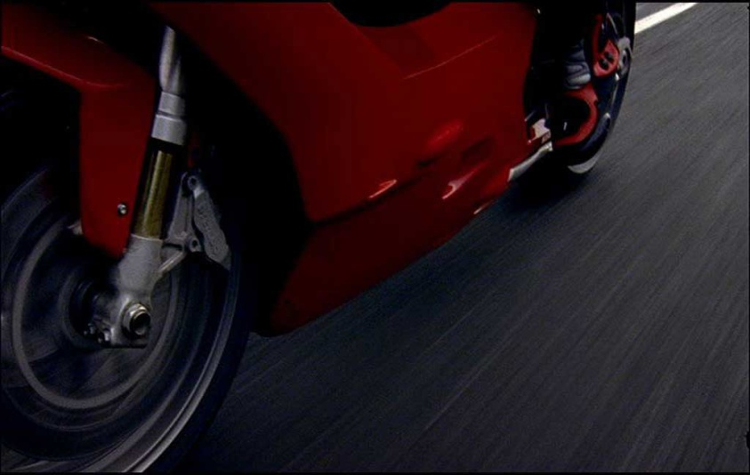
Motorcycle safety – research
In depth study of motorcycle accidents
Road Safety Research Report 54 (2004)
Car Driver Skills and Attitudes to Motorcycle Safety: A Review
Road safety Research Report 85 (2008)
Car Drivers' Attitudes and Visual Skills in Relation to Motorcyclists
Road safety Research Report 121 (2011)
Passion, Performance, Practicality: Motorcyclists’ motivation and attitudes to safety
  TRL Report PPR 442 (2009)

Slide 6
In depth study of motorcycle accidents
Research for DfT by Nottingham University.
A sample of 1,003 motorcycle accidents 1997-2002.
The study identified
A particular problem with other road users’ perceptions of motorcyclists, especially at junctions.
Often involve experienced older drivers who seem to have problems detecting approaching motorcycles.
Motorcyclists themselves have more problems with other types of accident e.g. on bends, overtaking or filtering accidents.

Slide 7
Car driver’s skills and attitudes to motorcycle safety: a review
Does the driver look at the motorcyclist?
Does the driver realise that it is a motorcyclist?
Does the driver correctly decide whether the motorcyclist poses a hazard?
Findings
Factors such as A-frame obscuration, movement and conspicuity. Also spatial frequency (width of the vehicle).
Looking depends on experience and practice, peripheral vision and attitudes. Speed may be important.
Driver may look but fail to see, due to spatial frequency but also expectations and previous exposure.
Empathy to motorcyclists appears to be important.
Drivers may look but fail to behave appropriately or may fail to notice the motorcycle.

Slide 8
Car Drivers' Attitudes and Visual Skills in Relation to Motorcyclists
Car simulator, video clips and eye tracking assessed drivers’ responses to motorcycles
Drivers who are also motorcyclists show more awareness than drivers who aren’t motorcyclists.
Experimental evidence that drivers might truly look at an approaching motorcycle but ‘fail to see it’.
Increasing drivers’ awareness of motorcycles and empathy with motorcycles is likely to increase recognition of motorcycle in hazardous situations.

Slide 9
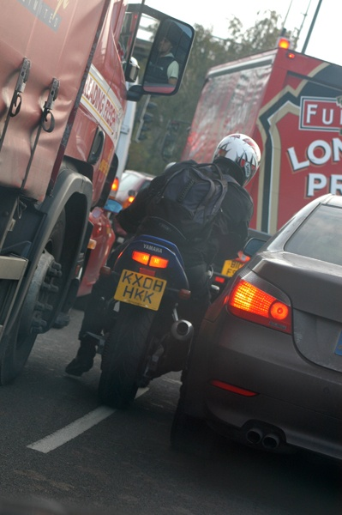
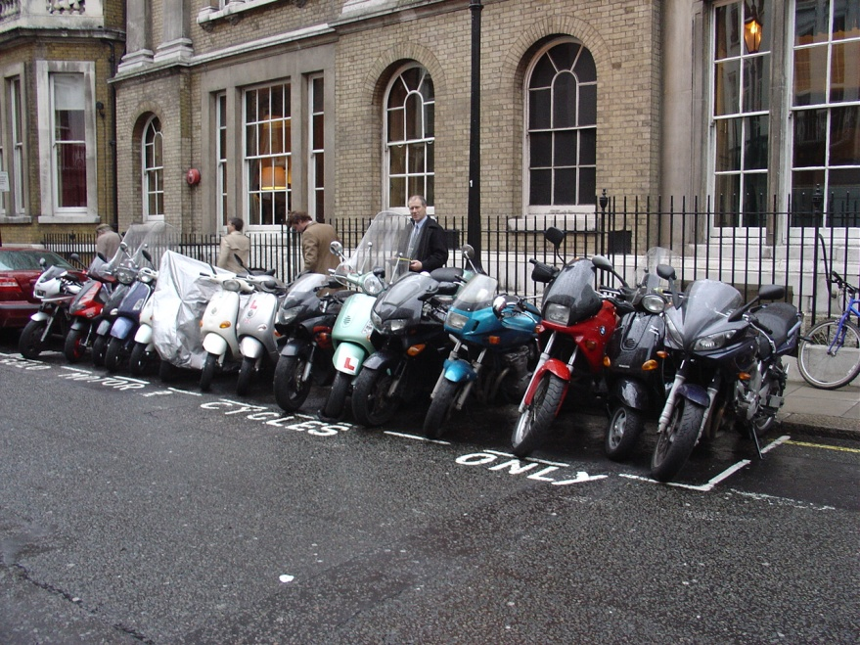
Passion, performance, practicality: a study of motorcyclists’ motivations
David Young, Simon Christmas 2009
Aim - To gain an understanding of motorcyclists’ attitudes to safety and the reasons behind the decisions that impact on their safety
Segmentation analysis - 1019 responses to 30 statements
8 factors
7 segments
F1 Power of the bike
F2 Belonging
F3 Relationship
with the bike
F4 Self-sufficiency
F5 Sensations
F6 Challenge of riding
F7 Showing off
F8 Release
Notes:
Think academy – stand at events, working with industry partners / riders, supported by website. Engaging with sports bikers.
Research on fatigue published Feb 08. Car driver attitudes phase one published May 08, phase 2 now under way. Training research to be published later this year.
Will work with NMC on future research needs.

Slide 10
Seven Segments
Look-at-me enthusiasts
24.8%
SHOWING OFF
Riding disciples
Performance disciples
16.3%
8.3%
Riding hobbyists
Performance hobbyists
14.5%
14.7%
PASSION
Car rejectors
Car aspirants
10.1%
11.2%
Page ▪ 10
PERFORMANCE

Slide 11
Passionate low-performance segments
Riding disciples
Passionate riders for whom riding is a way of life, built on a strong relationship with the bike itself and membership of the wider fraternity of riders
Riding hobbyists
Older summer-only riders who enjoy the social interaction with other riders almost as much as the riding itself – and who like to look the part
16.3%
14.5%
Page ▪ 11

Slide 12
Passionate high-performance segments
Performance disciples
Committed all-year round riders with a total focus on high performance riding – and a strong dislike for anything that gets in the way of it
Performance hobbyists
Solitary, summer-only riders, for whom riding is all about individual experiences and sensations – and who couldn’t care less what other
riders are doing
8.3%
14.7%
Page ▪ 12

Slide 13
Pragmatist (low passion) segments
Car rejectors
Escapees (often women) from traffic jams, parking tickets, fuel costs and other horrors of the car – who don’t care for motorcycles, but do care for
low-cost mobility
Car aspirants
Young people looking forward to getting their first car when age/finances allow – but for the time being just happy to have got their own wheels
10.1%
11.2%
Page ▪ 13

Slide 14
Showing off…
24.8%
24.8%
Look-at-me enthusiasts
Young (or never-grew-up) riders with limited experience but limitless enthusiasm, for whom riding is all about self-expression and looking cool
Page ▪ 14

Slide 15

The (OLD) Government's Motorcycling Strategy 2005-2010
Published February 2005
Mainstreaming motorcycling
Considered full range of issues, not just safety
Worked together on implementation, through National Motorcycle Council, including riders, industry, trainers, police, central and local government
Government’s response to Advisory Group on Motorcycling 1999-2004
Notes:
NMC sub groups - Road Safety and Publicity; Technical, Engineering and Environmental Issues; Training, Testing and Licensing; Transport Management, Planning and Transport Policy.

Slide 16
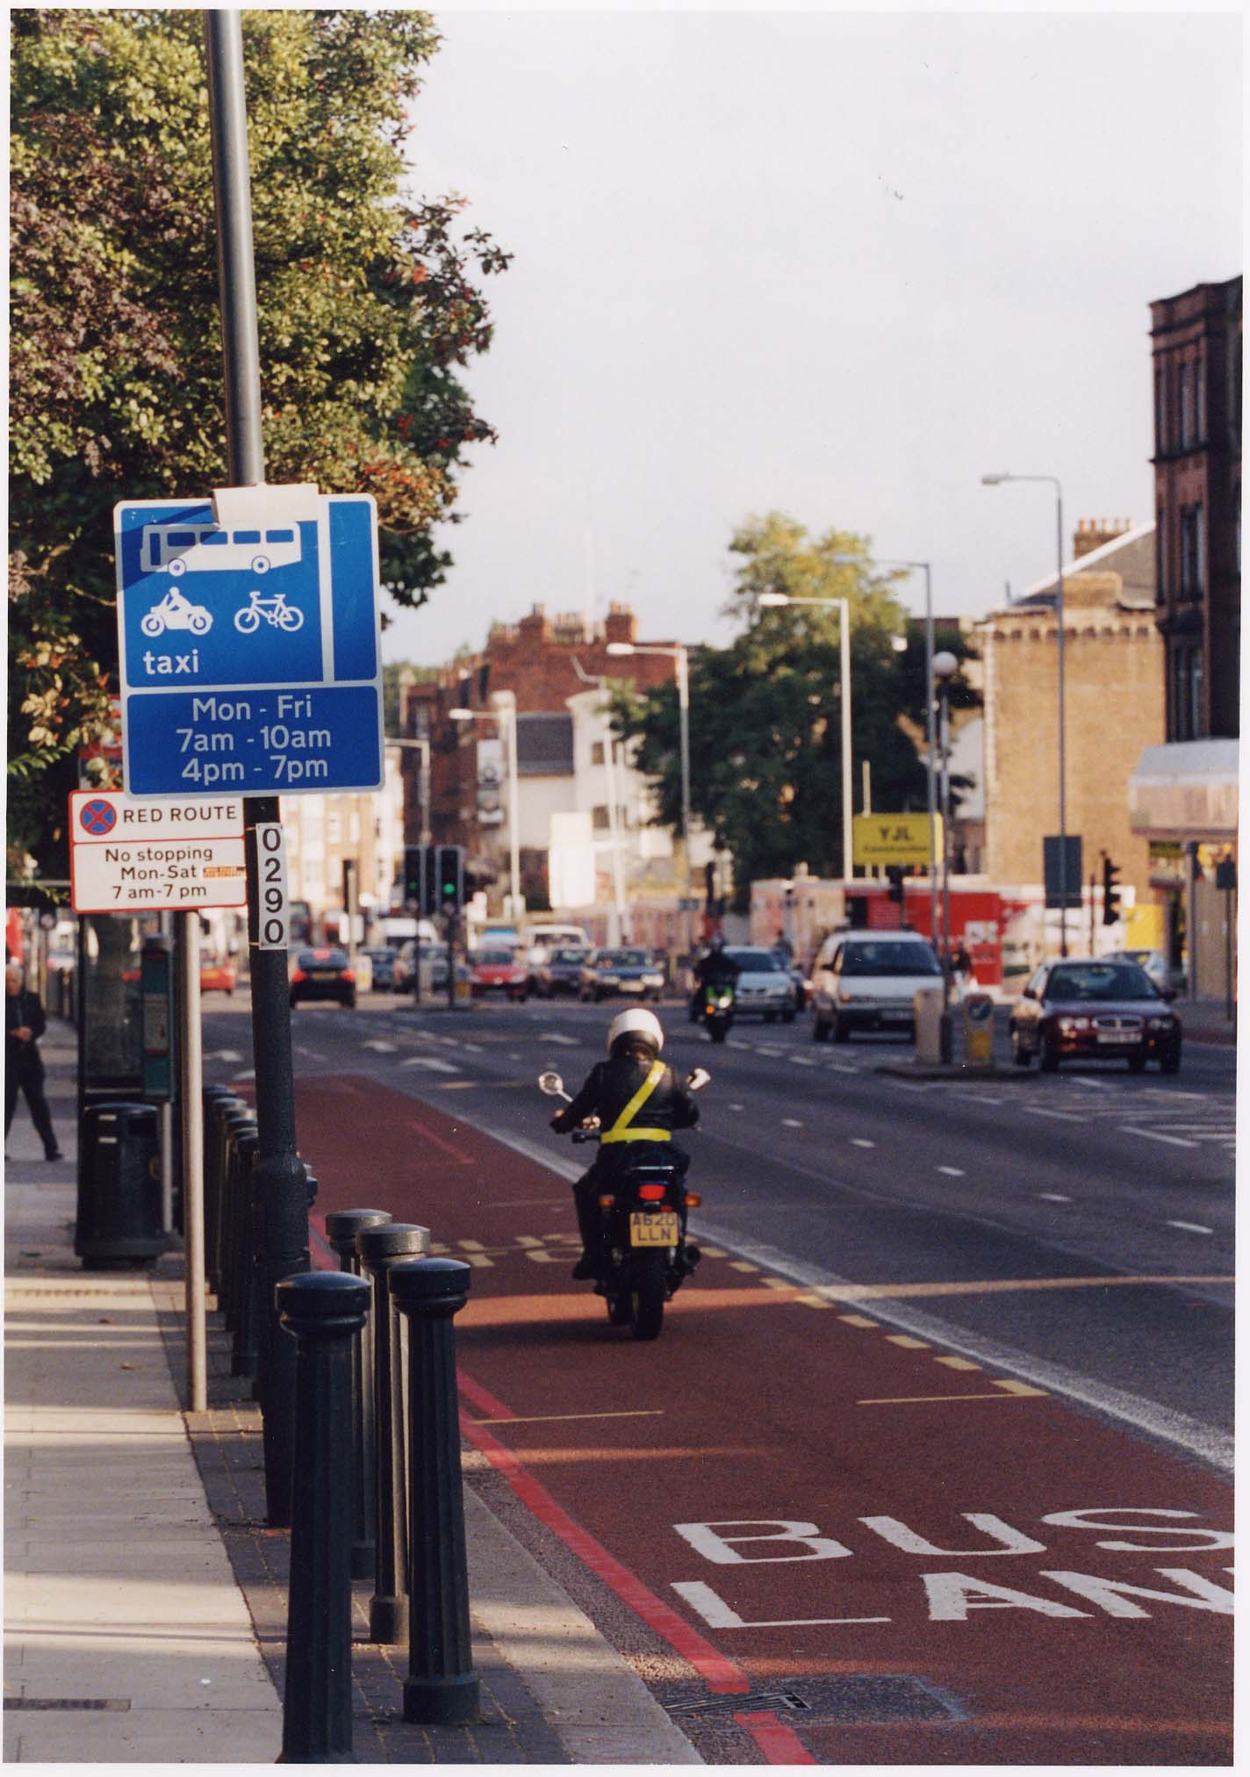
Strategy actions
Infrastructure - The Institute of Highway Engineers (IHE) guidelines on provision for motorcyclists on the highway www.motorcycleguidelines.org.uk
Engineering - SHARP scheme for improved consumer information on motorcycle helmets www.sharp.direct.gov.uk
Training – Enhanced Rider Scheme and register of post-test trainers
Publicity – Think! campaigns, Perfect Day, How Close, Named Rider, BSB sponsorship, partnership marketing.

Slide 17

How Close… (2006)

Slide 18
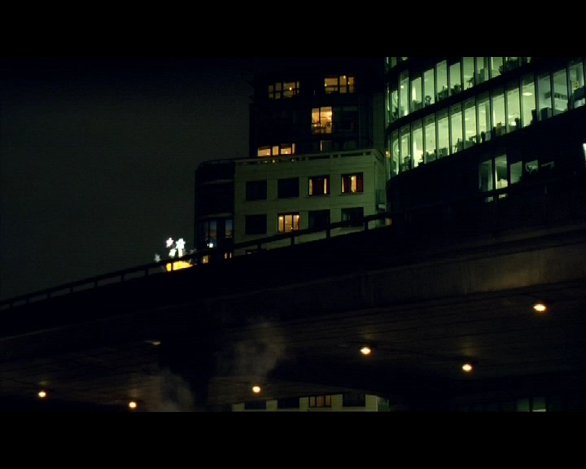
Named Rider (2010)

Slide 19
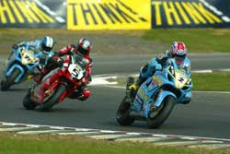
Partnership marketing

Slide 20
Strategic Framework for Road Safety
  Published 11 May 2011
  Key Themes and Measures
    Education and training
    Enforcement
    Local action
    Vision and indicators
      Empower local people and communities
      Reduce public service bureaucracy
      Foster more action by industry and volunteers

Slide 21
Enforcement
  Tougher and more efficient enforcement against serious offenders;
  Improved enforcement against drink and drug driving
  Increase some fixed penalty levels from £60 to £80-£100
  Fixed penalty notice for careless driving
  Requiring serious disqualified drivers to take remedial training and a linked test before regaining their licence
  Encourage courts to use powers to remove vehicles
  Uninsured and unlicensed driving

Slide 22
Speed Limits
  Evidence for effectiveness of 20 mph limits in urban areas – traffic calming
  Reissuing guidance to local authorities about speed limits
  Providing economic toolkit to help local authorities value safety, environmental and economic effects
  Reviewing raising motorway speed limit from 70mph to 80mph

Slide 23
Education and training
  Making it easier for road users to do the right thing
  Lifelong learning – road safety education in schools, support for parents
  Improved initial driver and rider training
  Remedial education for drivers and riders who make mistakes, with an expansion in the range of remedial education courses
  Think Campaigns – marketing and publicity

Slide 24
Driver and rider training
Updating driving and riding tests, including case studies in theory test and independent driving in practical test.
Trial of new learner driver syllabus focused on skills, attitude and understanding needed for safe driving, not just vehicle control skills.
Modernising the driver and rider instruction professions, to ensure all instructors can deliver the services that consumers need.
Motorcycle test review

Slide 25
Review of Motorcycle Testing (1)
2nd EU Driving Licence Directive (2000) – specified manoeuvres
New two-part test introduced April 2009
Multi purpose test centres
Review of test announced by Mike Penning MP, Road Safety Minister, 8 June 2010
Single event test
On road as far as possible
Interim findings announced 20 December 2010
Notes:
Voluntary trainer register a first step in raising standards – will consult on compulsory register in 2009
ERS gives discounts to riders taking post test training with a trainer on the register
3rd Directive – aim to implement with minimum disruption – already consulted informally, will consult formally too.

Slide 26
Review of Motorcycle Testing (2)
Main aims for the review –
  improve access to the test
  improve safety of the test
  maintain good riding standards
  not increasing costs

Slide 27
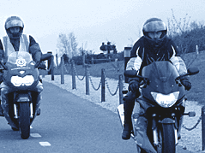
Review of Motorcycle Testing (3)
New higher speed avoidance manoeuvre
Could be on or off road
30kmh manoeuvre in road ride
Fewer slow manoeuvres – on or off road? How examined?
Research to test feasibility, safety, practicality, off road and on road
Findings will inform public consultation in 2012, phased implementation from 2013
Notes:
SHARP scheme launched Nov 07, first ratings published June 08
Working with Killspills group on diesel apills, including information for vehicle fleets as well as road maintenance / clear-up
Online User survey in 2006 - Showed rider awareness of safety requirements for brakes and tyres, but concerns about mirrors / visibility

Slide 28
Review of Motorcycle Testing (4)
Locations for on road testing
  Non residential
  Low traffic
  Safe pavement/verge for examiner
  Clear view
  Good road surface
  Minimal street furniture in high risk zone
  Set-up of markers – time and safety

Slide 29
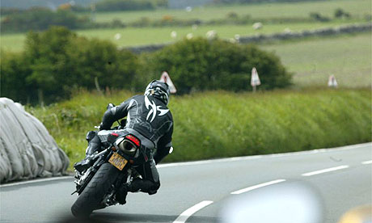
Learning to Ride project
Competence based syllabus - learning how to be a safe and responsible rider, not just how to pass the test
Trainer registration, to improve quality control
Improvements to Compulsory Basic Training
Notes:
IHIE guidelines published April 05, online Feb 08.
Bus lane guidance issued Feb 07, neutral on motorcycle access, replacing previous presumption against access – now for local highway authorities to decide on motorcycle access.

Slide 30
Any Questions?
Thank you

